Slide 1
Fuel Efficiency Prediction and Analysis
Presented By : Mohammed Bilal Alam

Slide 2


What Are We Doing?
“In this project,Our goal is to develop a predictive model that accurately forecasts fuel efficiency based on various vehicle attributes. By doing so, car manufacturers can optimize their designs, improve performance, and gain a competitive edge in the market. We aim to Uncover patterns, distributions and relationships within the data.”

Slide 3
Why Are We Doing this?
Innovate Automotive Design
Improve Performance
Support Sustainable Practices

Slide 4
How Are We Doing This
1
2
3
Analyze Data
Data Preprocessing
Data Visualization
6
5
4
Hyperparameter Tuning
Model Evaluation
Model Development

Slide 5

INTRODUCTION
In today's world, fuel efficiency is a critical factor for both environmental sustainability and economic savings.
Our project focuses on developing a robust machine learning model to predict the fuel efficiency of cars. Using a dataset that includes various attributes such as the number of cylinders, engine displacement, horsepower, vehicle weight, acceleration, model year, and origin

Slide 6
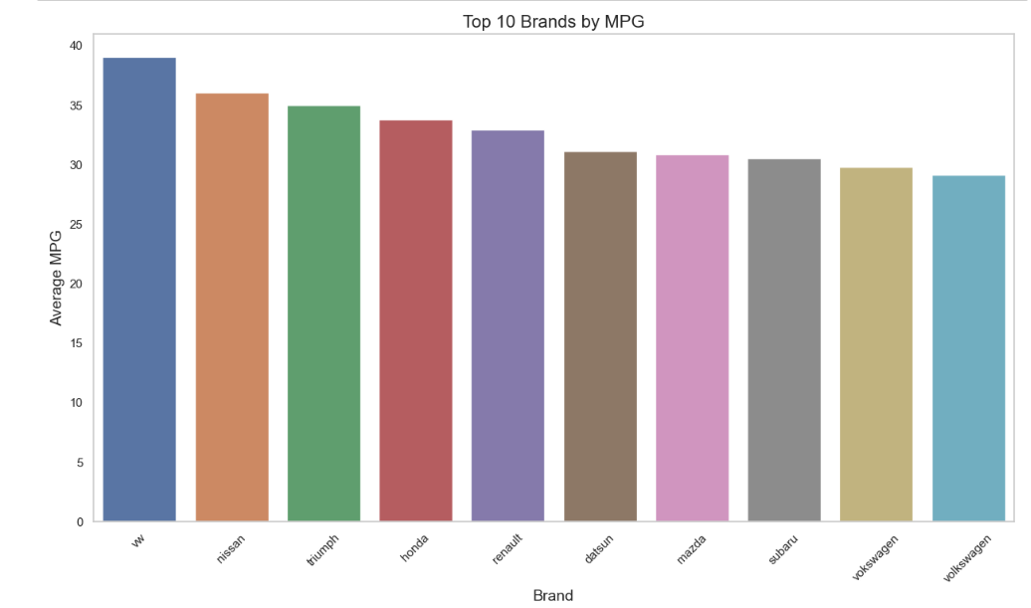
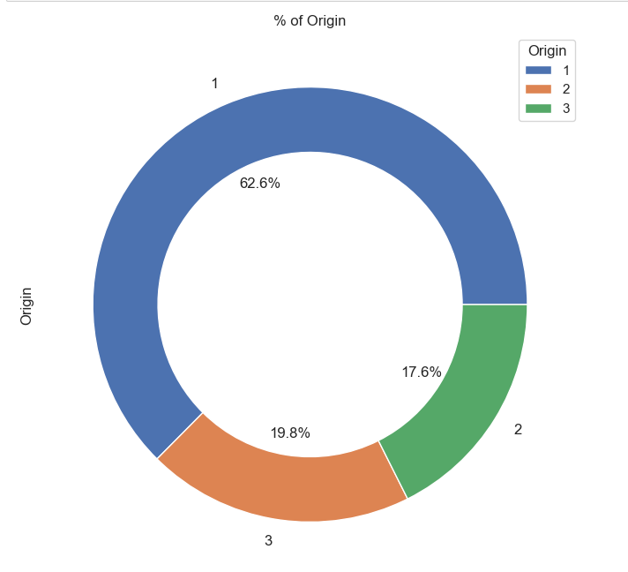
EXPLORATORY DATA ANALYSIS
EDA provided valuable insights and a solid foundation for building our machine learning model. By understanding the underlying patterns and relationships in the data.
The dataset includes various attributes such as mpg, cylinders, displacement, horsepower, weight, acceleration, model_year, origin, and car_name.
Visualizations revealed that newer model years tend to have higher mpg, indicating improvements in fuel efficiency over time.
Significant correlations were found between mpg and features like model_year, origin and acceleration
We explored about the brands who is performing well in terms of mpg

Slide 7
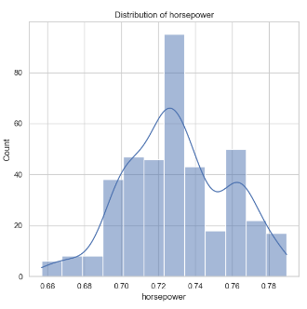
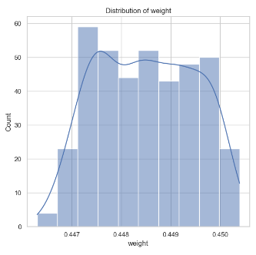
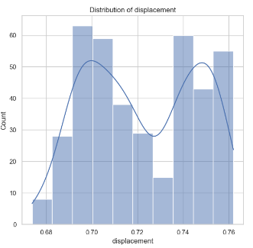
Data Preprocessing
We identified missing values in the horsepower column and filled it with the actual values by researching with the help of the other attributes available.
Outliers were detected using visualization techniques like box plots.
Some features were transformed to improve their distribution. For example, Box-Cox transformation was applied to highly skewed features to reduce skewness and approximate a normal distribution
get_dummies() was applied to origin and cylinders to create binary columns, ensuring that the machine learning algorithms can interpret these categories correctly.
Irrelevant or redundant features that did not contribute significantly to the prediction of mpg were removed to reduce noise and improve model performance.

Slide 8
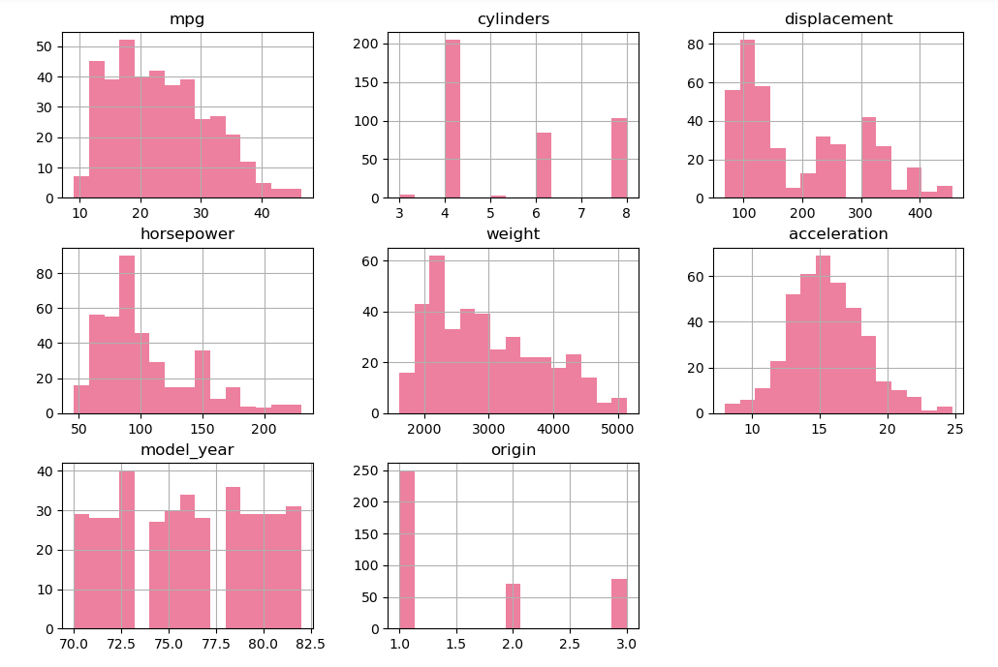
DISTRIBUTION OF THE DATASET
Data visualization is an essential part of the data analysis process that helps in understanding complex datasets through graphical representation

Slide 9
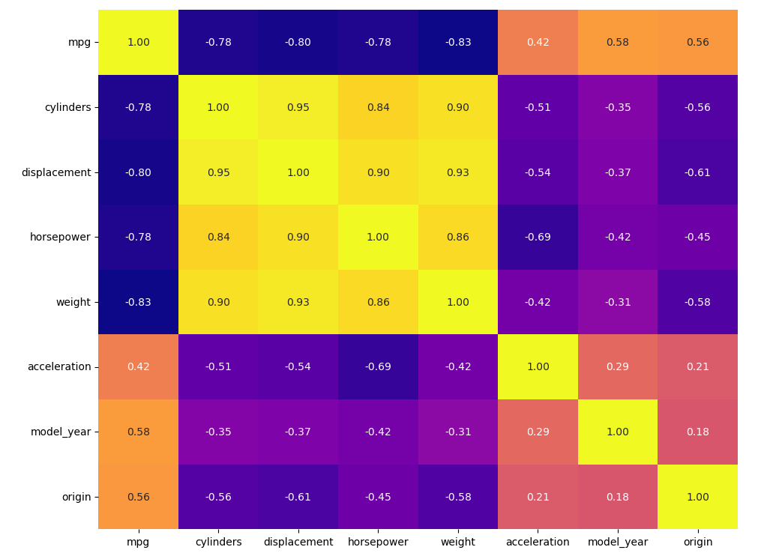
CORRELATION HEATMAP
Features like weight, displacement, cylinders, and horsepower have a strong negative correlation with mpg, indicating that these should be key predictors in our model.
Acceleration, model year, and origin show moderate positive correlations with mpg, suggesting they also contribute to fuel efficiency but to a lesser extent.

Slide 10

TRAIN TEST SPLIT
SPLITTING THE DATA INTO X & Y
We divided the data into training (80%) and testing (20%) sets.
Setting a random state ensures consistent results and using stratify=y maintains a proportional distribution of the target variable in both sets.
We divided the dataset into two parts: X and y.
"X" typically represents the independent Variables, and "y" represents the Dependent (target variable) that we want to predict or understand.

Slide 11
MODEL SELECTION
Linear Regression: Linear Regression is a simple and interpretable model that assumes a linear relationship between the independent variables (features) and the dependent variable (target).
Decision Tree Regression: Decision Tree Regression is a non-linear model that splits the data into subsets based on feature values, making decisions at each node until a final prediction is made at the leaf nodes.
Random Forest Regression: Random Forest Regression is an ensemble learning method that constructs multiple decision trees during training and outputs the mean prediction of individual trees.
Gradient Boosting Regression: Gradient Boosting Regression builds an ensemble of weak prediction models, typically decision trees, by sequentially minimizing the residual errors of previous models using gradient descent.

Slide 12
Model | Mean Squared Error | Mean Absolute Error | Root MSE | R-Squared
Linear Regression | 6.44 | 1.91 | 2.54 | 0.88
Decision Tree | 10.23 | 2.25 | 3.20 | 0.81
Random Forest | 4.61 | 1.59 | 2.15 | 0.91
Gradient Boosting | 5.10 | 1.71 | 2.26 | 0.91
Random Forest and Gradient Boosting are the top choices for this dataset due to their strong performance and generalizability
We will further optimize Random Forest and Gradient Boosting models with hyperparameter tuning

Slide 13
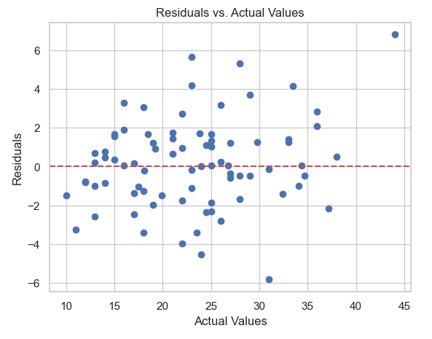
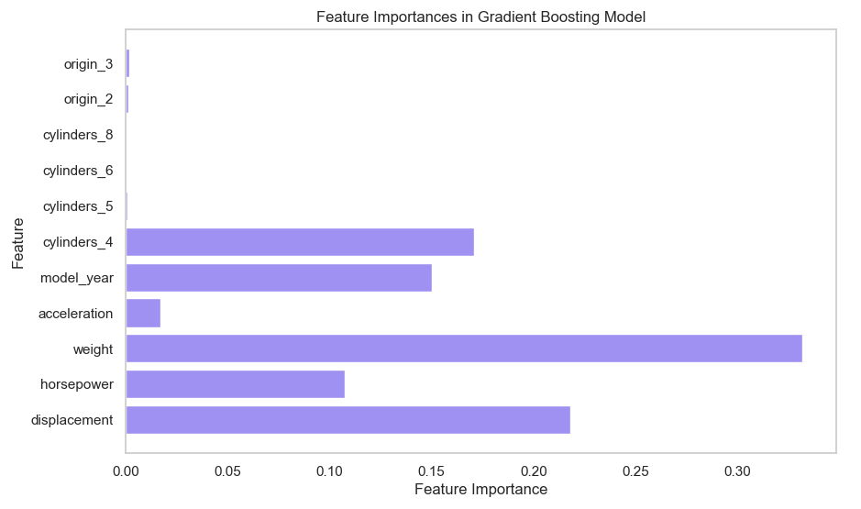
Hyperparameter Tuning
After doing GridSearchCV on Random Forest and Gradient Boosting
Both models have almost the same mean RMSE (2.77), indicating that, on average, their prediction errors are quite similar.
The Random Forest Regressor has a higher standard deviation (1.06) compared to the Gradient Boosting Regressor (0.92).
This suggests that the Gradient Boosting Regressor's performance is more consistent across different folds of the cross-validation.

Slide 14

Conclusion
The Gradient Boosting Regression model demonstrated the highest performance, achieving an R² value of 0.90, indicating it explains 90% of the variance in fuel efficiency (mpg)
All models showed promising performance, with Gradient Boosting Regression outperforming others in terms of predictive accuracy.
The study relies on a single dataset, potentially limiting its generalizability to diverse populations and vehicle types.
With only 398 instances, the dataset size is relatively small, which may affect the robustness and reliability of the models.

Slide 15
Thank You!

